Slide 1
Getting your Salesforce Organization Ready

Slide 2
Session Objectives
At the end of this session participants will be able to:
Understand Company Profile
Understand User Interface setting
Undertand user profile
Create user Profiles
Define and Create User
Define Fiscal Year
Define Currency Management

Slide 3
Company Profile

Slide 4
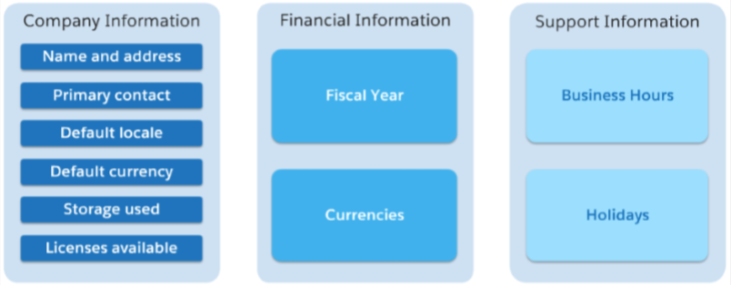
Company Profile
Contains core information for your company
Salesforce.com bills an organization based on total licenses, not on active users
Company profile contains following information of your company

Slide 5
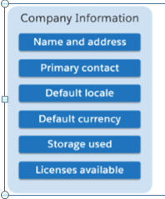
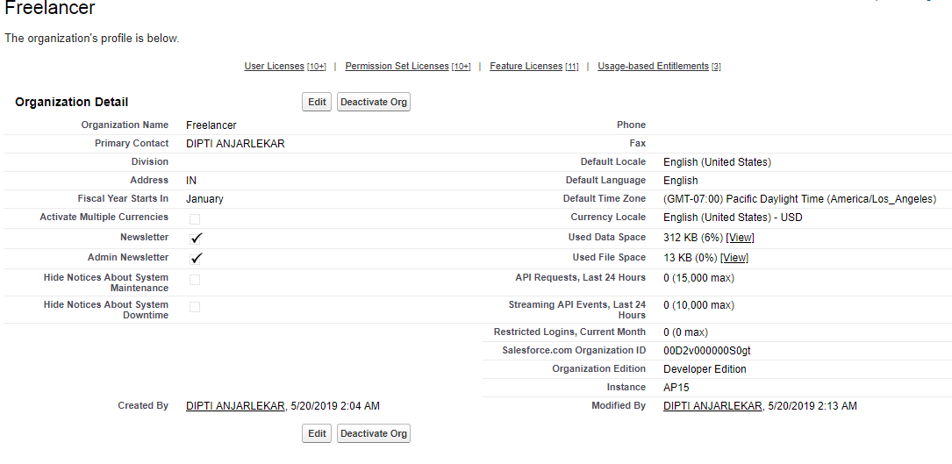
Company Profile

Slide 6
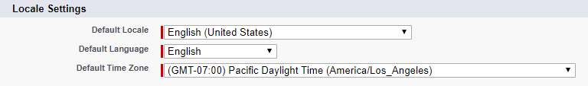
Local Setting
Local determines how date, time, number, name are displayed
Language determines the language in UI and in help and training
Time Zone determines the time zone in event start and end times , and in Date/time zone

Slide 7
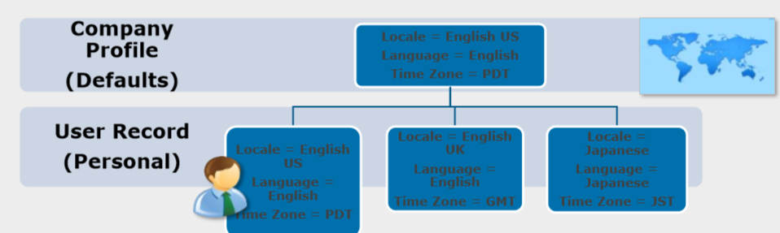
How do Locale Settings Work?
Set your locale settings at the company level and at the user level.
Set your company defaults for your organization’s head office.
New users automatically inherit the company defaults.
Modify personal locale settings for each user as required.

Slide 8
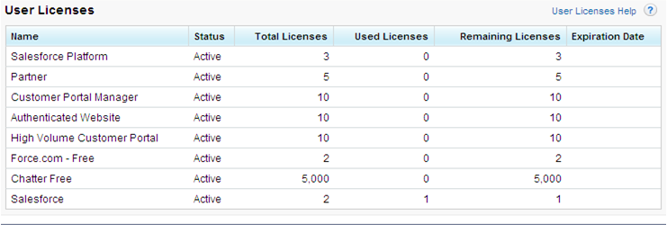
Salesforce Users Licenses
To view a list of the active user licenses your organization has purchased
Click Setup | Company Profile | Company Information.
Indicates the status of the license
Indicates the number of licenses for which your organization is billed and that are available to you.
Indicates the number of licenses that you have assigned to users.
Indicates the number of unused licenses.
Indicates the number of licenses that are expired

Slide 9
Salesforce Users Licenses
Salesforce User
Designed for users who require full access to standard CRM and Force.com AppExchange apps.
Users with this user license are entitled to access any standard or custom app.
Salesforce Platform User
Designed for users who require full access to standard CRM and Force.com AppExchange apps.
Users with this user license are entitled to access any standard or custom app.
In addition, they are entitled to use core platform functionality such as accounts, contacts, reports, dashboards, documents, and custom tabs.
However, these users are not entitled to some user permissions and standard apps, including standard tabs and objects such as forecasts and opportunities.
Salesforce Platform Light User
Designed for users who need access to custom apps but not to standard CRM functionality.
Users with this user license are entitled to the same rights as Salesforce Platform users, except the amount of times the user can log in is limited monthly.

Slide 10
Salesforce Users Licenses
Force.com - One App User
Force.com - One App users are entitled to the same rights as Salesforce Platform users
They have access to an unlimited number of custom tabs.
They are limited to read-only access to the Accounts and Contacts objects.
Users with a Force.com - One App user license cannot edit or create new dashboards and can only view dashboards if the Running User of the dashboard also has a Force.com - One App license
Force.com – Free User
Entitled to the same rights as Salesforce Platform users, plus they have access to an unlimited number of custom tabs.
However, they are limited to the use of one custom app, which is defined as up to 10 custom objects, and they do not have access to Accounts and Contacts objects.
Ideas and Answers Internal User
Designed for internal Salesforce users who only need access to the ideas and answers features.
This license allows users to access the Ideas tab, Answers tab, Home tab, and up to three other custom tabs.
Notes:
Ideas is a community of users who post, vote for, and comment on ideas. An Ideas community provides an online, transparent way for you to attract, manage, and showcase innovation.

Slide 11
Salesforce Users Licenses
Content Only User
Designed for users who only need access to the Content app.
This license allows users to access the following tabs: Workspaces, Content, Subscriptions, Ideas, and Home. Each license provides 500 MB of file storage.
Knowledge Only User
Designed for users who only need access to the Salesforce Knowledge app.
This license provides access to the following tabs: Articles, Article Management, Home, Reports, and custom tabs.
The Knowledge Only User license includes a Knowledge Only profile that grants access to the Articles tab via the “View Articles” user permission.
To view and use the Article Management tab, a user's profile must include the “Manage Articles” permission
Chatter Free User
Designed for Unlimited, Enterprise, and Professional Edition users that don’t have Salesforce licenses but need access to chatter.
These users can access standard Chatter people, profiles, groups, and files.
They can't access any Salesforce objects or data.

Slide 12
Sites Users
Guest User
Designed for public users who access your Force.com sites.
The number of Guest User licenses determines the number of sites that you can develop for your organization.
You can create one active site for each Guest User license. Enterprise and Unlimited Editions each come with 25 Guest User licenses.
Developer and Force.com - Free Editions each come with one Guest User license.

Slide 13
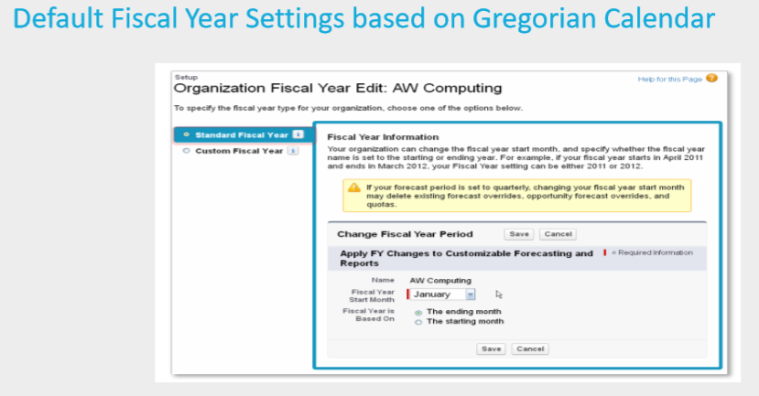
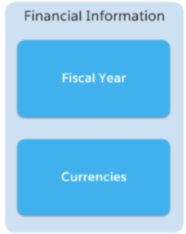
Standard Fiscal Year

Slide 14
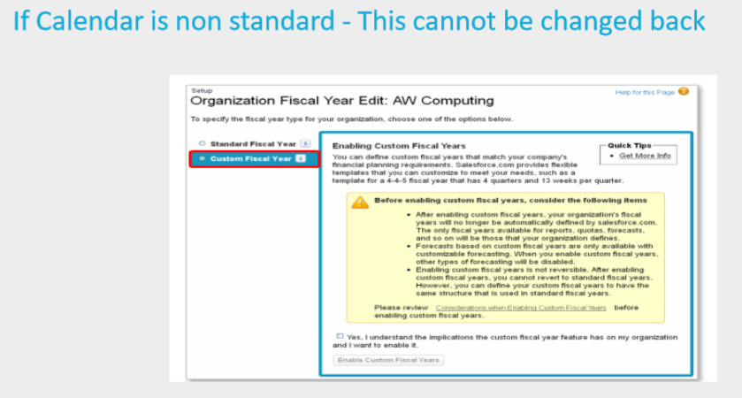
Custom Fiscal Year

Slide 15
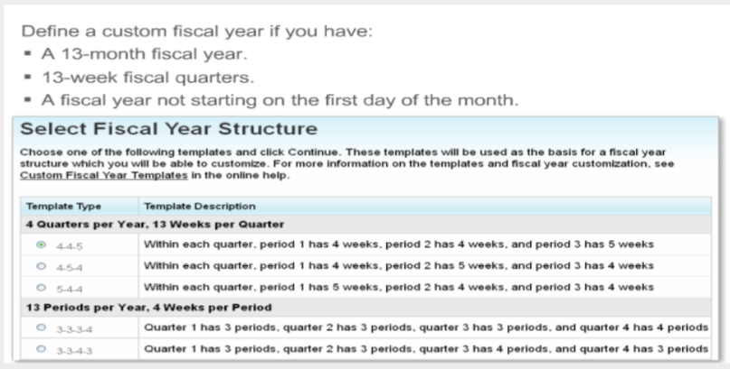
Custom Fiscal Year

Slide 16
Currencies
Are very important and required field available on objects like Quota or Annual Revenue
It is use to show losses and profit in financial reporting
Currency is a required field on every object where currency field is available and defined
In a single currency organization,
the Salesforce administrators set
the currency locale, default language, default locale, and default time zone for their organizations
the users can set
their individual language, locale, and time zone on their personal settings pages.
In a multiple currency organization,
the Salesforce administrators set
the corporate currency, default language, default locale, and default time zone for their organizations
the users can set
their individual currency, language, locale, and time zone on their personal settings pages

Slide 17
Types of currencies
Following are types of currencies:
Active currency
Multiple currency
Personal currency
Corporate currency
Conversion rates
Inactive currency
Record currency

Slide 18
Currency types
Active currency
Currency in which your organization actively does business
Can be entered in opportunities, forecasts and other items
Personal currency
User’s default currency for quotas, forecasts and reports
Must be one of the organization’s active currency
Corporate currency
Currency in which your organization’s corporate headquarters reports revenue
Serves as the basis for all currency conversion rate
Conversion rates
Rates used to convert between the corporate currency and the multiple currencies used by your organization.
Maintained by system administrators

Slide 19
Currency types
Inactive currency
Currency that your organization no longer uses
You may have existing records that use inactive currencies but you cannot enter new amount using inactive currencies
Record currency
Default currency for an individual record.
Every record has a currency field that determines the currency type for amount field in that record

Slide 20
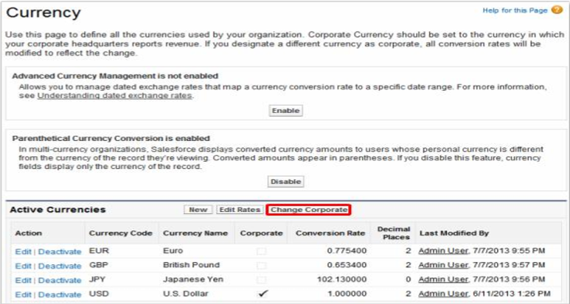
Multiple currency organization

Slide 21
Currency Management
Salesforce support Multi-currency
Currency can be defined at the following levels:
Organization Profile
User Record (Personal setup)
Record (opoortunity)
Currency is a required field on every object where the currency field have been added or was originally defined
Administrator can set new exchange rates for any given currency. Maximum granularity is One / day
To setup Exchange dated currency
Administration Setup → Company Profile → Manage Currencies

Slide 22
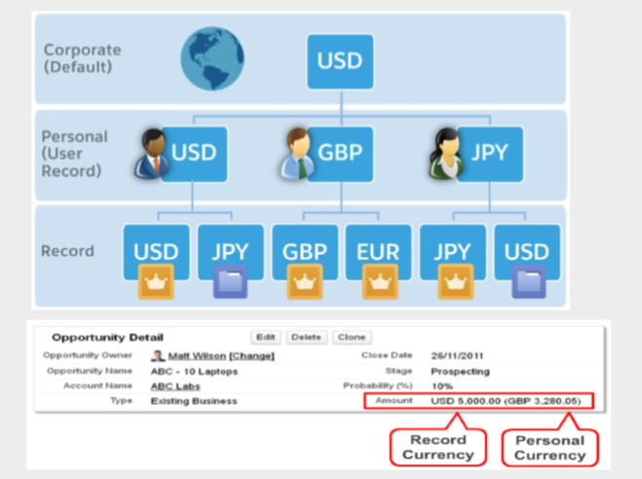
Working with multiple currencies

Slide 23
Managing Multiple Currencies
Your organization can set up the ability to use multiple currencies in opportunities, forecasts, quotes, reports, and other data.
To use multiple currencies:
Contact salesforce.com to enable Multi-Currency for your organization
Designate your corporate currency
Activate additional currencies for your organization
To use dated exchange rates, enable advanced currency management
Set conversion rates for new currencies

Slide 24
Corporate Currency
Reflects the currency in which your corporate headquarters reports revenue.
A salesforce.com representative initially sets your corporate currency upon activation of the feature.
To change your corporate currency:
Click Your Name | Setup | Company Profile | Manage Currencies.
Click Change Corporate.
Choose a new corporate currency from the list of active currencies, and click Save.

Slide 25
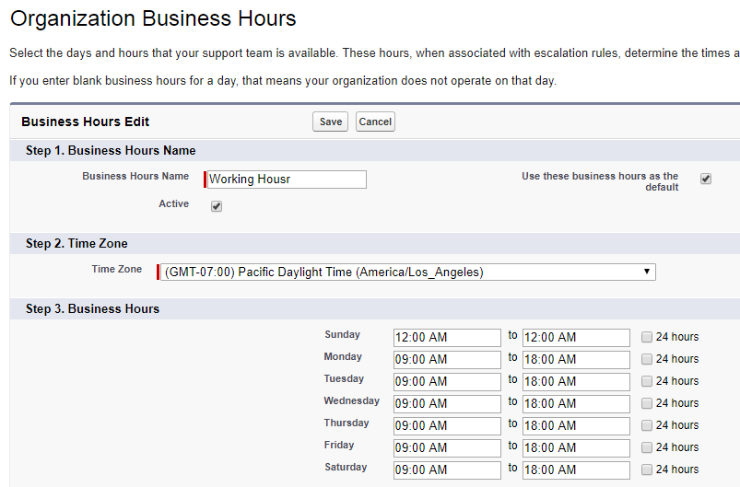
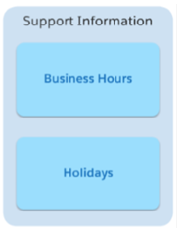
Organization Business Hours
Note - If users are logged in when their login hours end, they can continue to view their current page, but they can’t take any further action

Slide 26
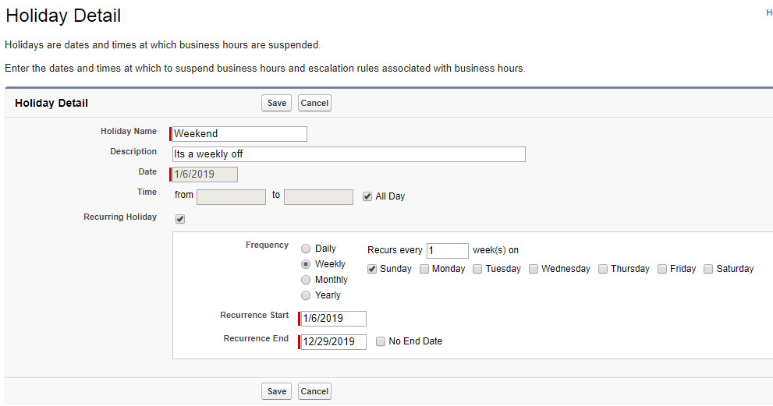
Company Holidays
Holidays are dates and times at which business hours are suspended.

Slide 27
User Management

Slide 28
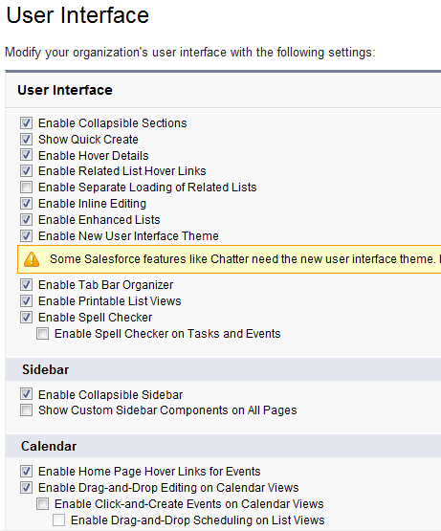
User Interface Setting
User Interface setting can modify to customize how end user see and interact with Salesforce.
Scenario : When viewing account user would like to make quick changes to field without accessing every record
Select Setup | Customize | User interface
These settings are global so enabling them will affect all user

Slide 29
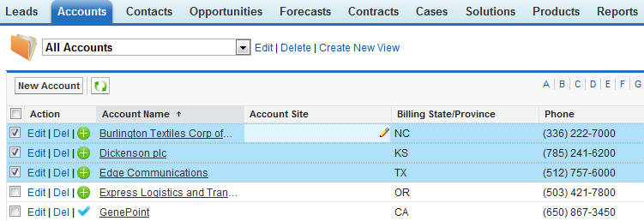
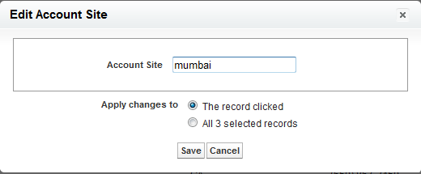
User Interface Setting
Select require records and change require field in one go, instead of doing one by one

Slide 30
User Management
Depending on your organization's Salesforce edition and the additional features your organization has purchased, you may have user licenses—such as Marketing, Connect Offline, and Sales Anywhere
It will give users the ability to access other features that are only available with a specific user license.
A user can be assigned to one or more of these licenses.
You can also set up accounts for users outside your organization who need to access a limited set of fields and objects.
These user licenses can grant access to Customer Portal, partner portal, or Self-Service.
Finally, using Salesforce to Salesforce, you can create connections to share records with other Salesforce users outside of your organization

Slide 31
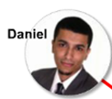
Users
User is a person who controls or has rights to a particular data record
User is authorized to access records determined by their Roles and Profiles
A user record will have the below information:
Username & password
Role associated with the user
Profile associated with the user
Current status of the user (active / inactive)
Security and access information also includes assigning either a salesforce or chatter license to user.
The user license determine profiles available to user.
Local information to identify location and currency information specific to each user

Slide 32
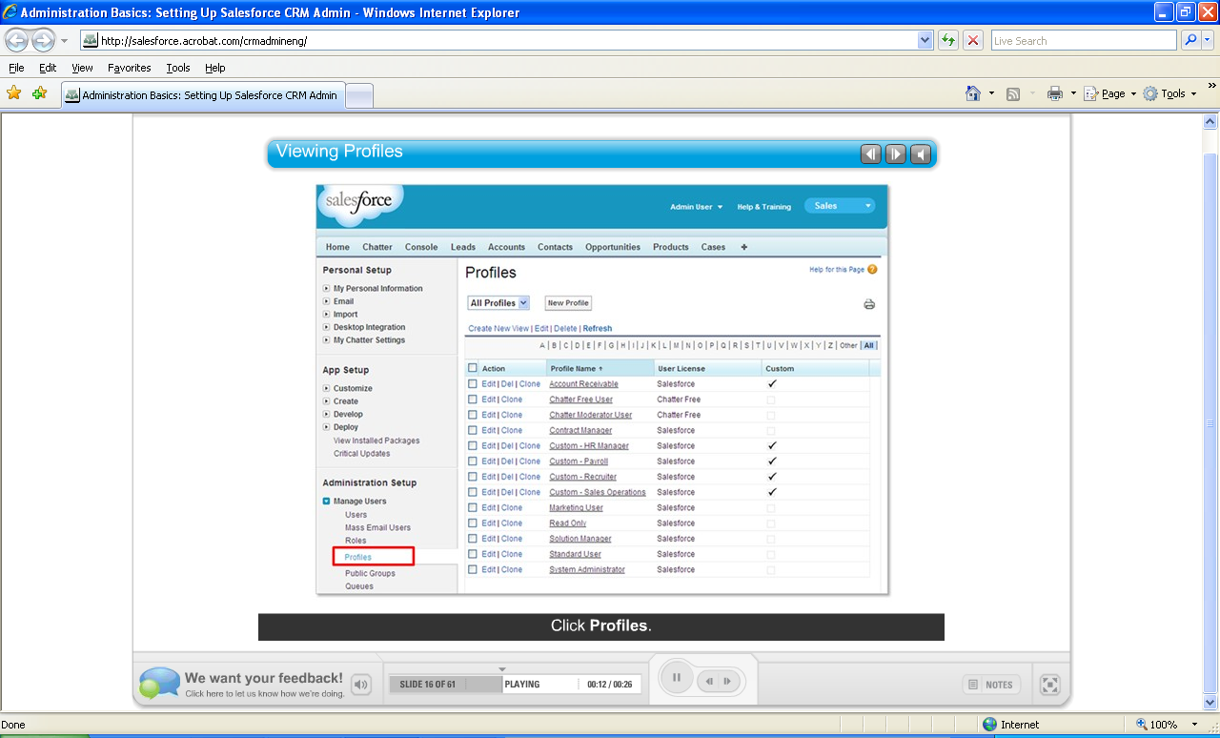
User Profiles
Is a collection of setting and permissions that determines what the user can do with records they have access to
It determines which page layout he or she sees and how they view those records
Select Setup | Manage Users | Profiles,

Slide 33
User Profile
A profile sets the apps, tabs, record types, page layouts and field level security for a user
A profile can be assigned to many users, but a user can be assigned a single profile at a time.
Profiles control:
Which standard and custom application users can view
Which tabs users can view
Which record types are available to users
Which page layouts users see
Object permissions that allow users to create, read, edit, and delete records
Which fields within objects users can view and edit
Permissions that allow users to manage the system and applications within it
The hours during which and IP addresses from which users can log in

Slide 34
Profiles Types
Standard Profiles:
By default, salesforce provides below standard profiles. We cannot delete standard ones.
Each of these standard ones includes a default set of permissions for all of the standard objects available on the platform.
System Administrator
Standard User
Solution Manager
Marketing User
Contract Manager
Read Only
Custom Profiles
Custom ones defined by us. They can be deleted if there are no users assigned to that particular one.

Slide 35
Profiles : Standard Profiles
System Administrator
Can configure and customize the application.
Has access to all functionality that does not require an additional license.
Can edit any quota, override forecasts, and view any forecast.
Permissions | Functions Controlled
Activate Contracts | Change contract status to Activate
Affected by Divisions | Filter a user’s search results, list views, and reports by division
API Enabled | Access any Salesforce API
Background Report Export | Run reports in the background, and export results as a CSV or Excel file on completion.
Convert Leads | Convert leads into accounts, contacts, and opportunities.
Create and Customize Reports | Create, edit, and delete reports.
Customize Application | Edit messages and custom links; Modify standard picklist values; Create, edit, and delete custom fields; Create, edit, and delete page layouts (also requires the “Edit” permission for the record, for example, “Edit” on accounts); Set field-level security; and many more
Notes:
There are many other permissions given to user, we are just listed few one

Slide 36
Profiles : Standard Profiles
Standard User
Can create and edit most major types of records, run reports, and view the organization's setup.
Can view, but not manage, campaigns. Can create, but not review, solutions.
Can edit personal quota and override forecasts.
Permissions | Functions Controlled
Affected by Divisions | Filter search results, list views, and reports by division.
Convert Leads | Convert leads into accounts, contacts, and opportunities.
Create and Customize Reports | Run, create, edit, save, and delete reports;
Edit Events | Create, edit, and delete events
Edit Opportunity Product Sales Prices | Enable users to change the sales price on products
Edit Tasks | Create, edit, and delete tasks
Import Personal Contacts | Import personal accounts and contacts using the import wizard
Override Forecasts | Specify if products and price books are available in Connect Offline
Notes:
There are many other permissions given to user, we are just listed few one

Slide 37
Profiles : Standard Profiles
Solution Manager
Can review and publish solutions.
Also has access to the same functionality as the Standard User
Can manage solution categories
Permissions | Functions Controlled
Products Show in Offline | Make products and price books available in Connect Offline.
Run Reports | View dashboards based on reports
Affected by Divisions | Filter search results, list views, and reports by division
Convert Leads | Convert leads into accounts, contacts, and opportunities.
Create and Customize Reports | Create, edit, and delete reports.
Edit Events | Create, edit, and delete events.
Edit Forecasts | Create, edit, and delete non-customizable forecasts.
Edit Personal Quota | Change their quota for customizable forecasts.
Notes:
There are many other permissions given to user, we are just listed few one

Slide 38
Profiles : Standard Profiles
Marketing User
Can manage campaigns, import leads, create letterheads, create HTML email templates, manage public documents, and update campaign history via the import wizards.
Also has access to the same functionality as the Standard User.
Permissions | Functions Controlled
Affected by Divisions | Filter search results, list views, and reports by division.
Convert Leads | Convert leads into accounts, contacts, and opportunities
Create and Customize Reports | Create, edit, and delete reports
Edit Events | Create, edit, and delete events
Edit Forecasts | Edit HTML Templates
Edit Opportunity Product Sales Prices | Change the sales price on opportunity line items.
Edit Personal Quota | Change their quota for customizable forecasts.
Edit Tasks | Create, edit, and delete tasks.

Slide 39
Profiles : Standard Profiles
Contract Manager
Can create, edit, activate, and approve contracts.
Can also delete contracts as long as they are not activated. Can edit personal quota and override forecasts.
Permissions | Functions Controlled
Activate Contracts | Change contract status to Activated.
Affected by Divisions | Filter search results, list views, and reports by division.
Approve Contracts | Approve or reject a contract from a related list.
Convert Leads | Convert leads into accounts, contacts, and opportunities.
Create and Customize Reports | Create, edit, and delete reports
Edit Events | Create, edit, and delete events.
Edit Forecasts | Create, edit, and delete non-customizable forecasts
Edit Personal Quota | Change their quota for customizable forecasts
Edit Self-Service Users | Enable and disable contacts for Self-Service and Customer Portal access.

Slide 40
Profiles : Standard Profiles
Read Only
Can view the organization's setup, run and export reports, and view, but not edit, other records
Permissions | Functions Controlled
Create and Customize Reports | Create, edit, and delete reports
Products Show in Offline | Make products and price books available in Connect Offline.
Run Reports | Run reports and dashboards
View Setup and Configuration | View the organization setup details on the Setup pages; Run user reports; View the setup audit trail; Check field accessibility for users
Deliver Uploaded Files and Personal Content | Enables non-Content users to create content deliveries, and enables Salesforce CRM Content users to create content deliveries using documents in their personal workspaces.

Slide 41
What is Permission Sets?
The permission set is also very similar to profile.
Whatever you can manage at profiles (Like Object permissions, Field Permissions, User permissions, Tab settings, App settings, Apex class permission, visualforce permission) the same you can manage here also.
But the main difference between these two is that user can have only one profile and can have multiple permission sets at a time.
So we can define profiles to grant minimum permissions and settings that every type of user needs, then we can use permission set to grant additional access.

Slide 42
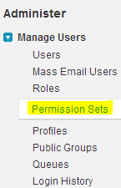
What is Permission Sets?
Examples:
1. We have many users in your organization with some fundamental job functions. We can assign all of then with one profile that grants them all access to do their job. But some set of people are working on special apps or some special functionality, for this type of special users we can create permission sets and can be assigned to them.
2. Some users need some temporary access to a specific set of fields and objects we can create a permission set with those object & field access and we can assign those specific users.
Navigation: Setup -> Administer -> Manage users -> Permission sets

Slide 43
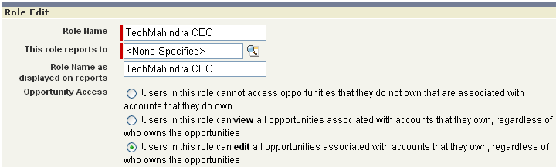
Roles
Role is the Job Title of a User that he holds in AN Organization.
Every user must be assigned a role.
Every role reports to another role and form a Role Hierarchy.

Slide 44
What is Role Hierarchies?
A role hierarchy controls the level of visibility that users have to an organization data.
By defining role hierarchies we can share access to records.
Users assigned to roles near the top of hierarchies like (CEO, executives, and other higher level roles) get to access the data of all users who fall directly below them I hierarchy.

Slide 45
Role hierarchies behaviors.
A manager will always have access to the same data as his or her employees, regardless of the org-wide default settings. For custom objects, you can override this behavior by deselecting the ‘Grant Access Using Hierarchies’ check box.
Users who tend to need access to the same types of records can be grouped together—we’ll use these groups later when we talk about sharing rules.

Slide 46
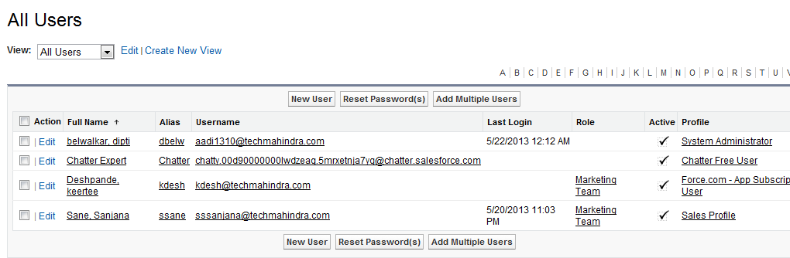
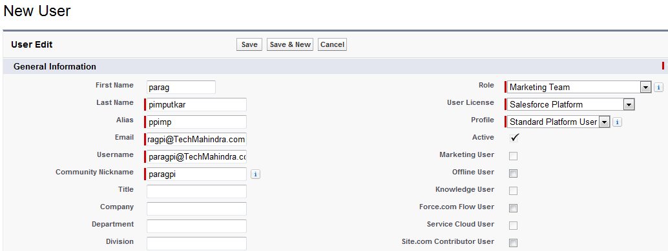
User Setup - Create New User
1. Click on New User Button
Select Setup | Manage Users | Users
2. Provide require details along with User license and profile
Notes:
In active user
don’t count towards the user licenses
Cannot login to salesforce
Still own all their data, admin can later change the ownership

Slide 47
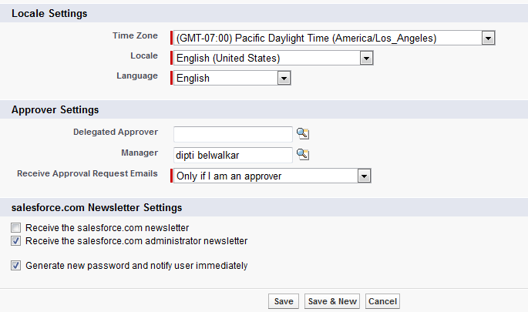
User Setup - Create New User
3. Specify Local, Language & approver setting
4. Deselect Generate new password and notify

Slide 48
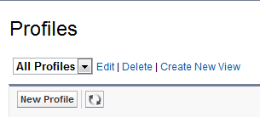
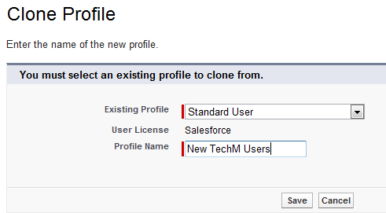
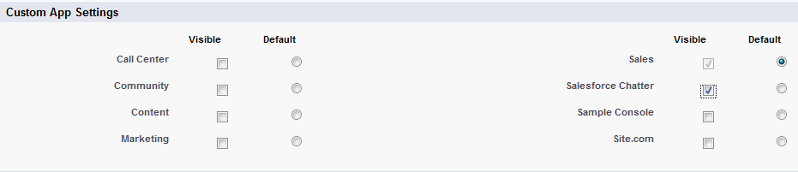
User Setup – Create Profile
Now create new profile and assign it to newly created user
Setup | Manage Users | Profile,
click on New Profile
On clone profile page, select existing profile as starting point, select Standard User as existing Profile name and provide profile name
Use Custom App Settings to change visibility of profile in different applications

Slide 49
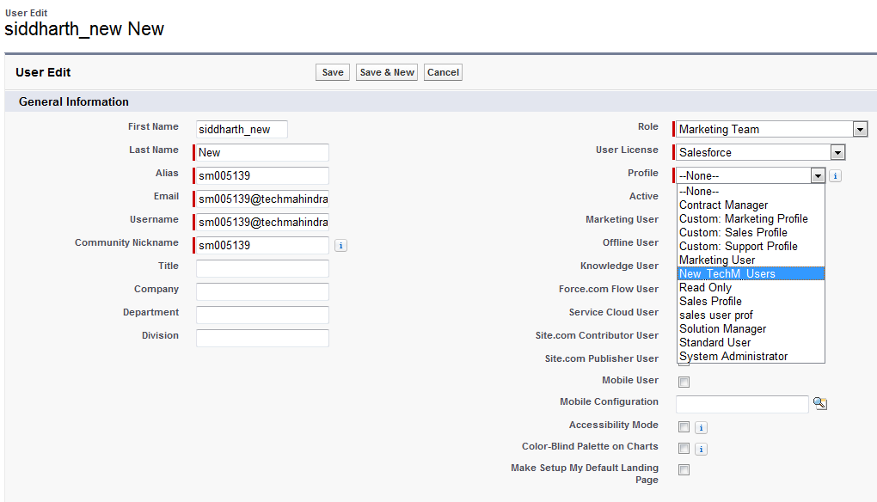
User Setup – Assign Profile to user
Now assign this profile to user
Select Setup | Manage Users | Users
Search for user
Click edit, change profile to newly created profile
Click Save

Slide 50
Salesforce Customization
Troubleshooting User Login Issues

Slide 51
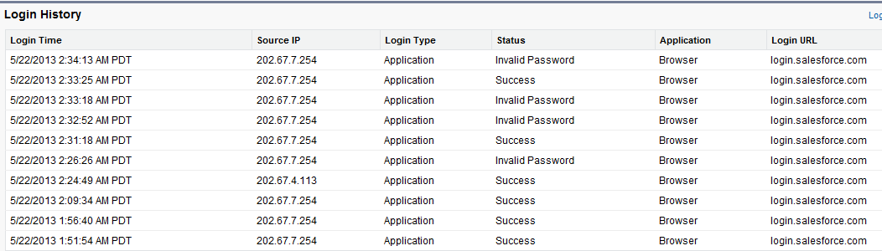
Troubleshooting User Login Issues
Scenario: Deniel is trying to access his account, but he is not able to login successfully
Solution: Check if error is due to invalid password, we need to check login history related to user, check ‘status’ field
Step 1. Select Setup | Manage Users | Users | Name of User
Step 2. Check Login History
if there is no entry for login, means user was probably using incorrect username

Slide 52
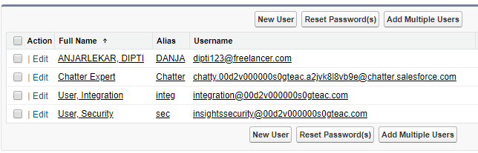
Troubleshooting User Login Issues
Step 3. Click on Reset Password to get new password on mail
It’s good practice to let users reset their passwords themselves by clicking the Forgot your password? link on the login page
Step 4. Click on unlock button to unlock user account

Slide 53
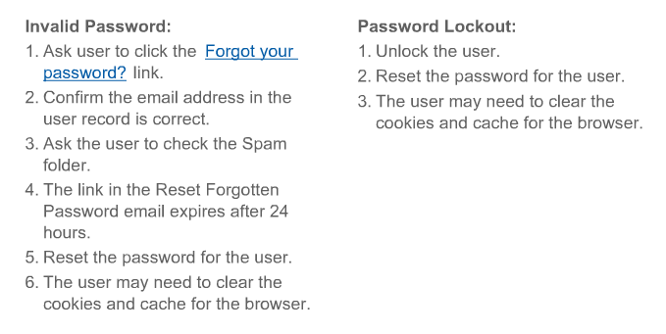
Troubleshooting User Login Issues

Slide 54
Troubleshooting User Login Issues
What will happened when a profile is logged in and login hrs passed?
What is User Profile Login restriction

Slide 55
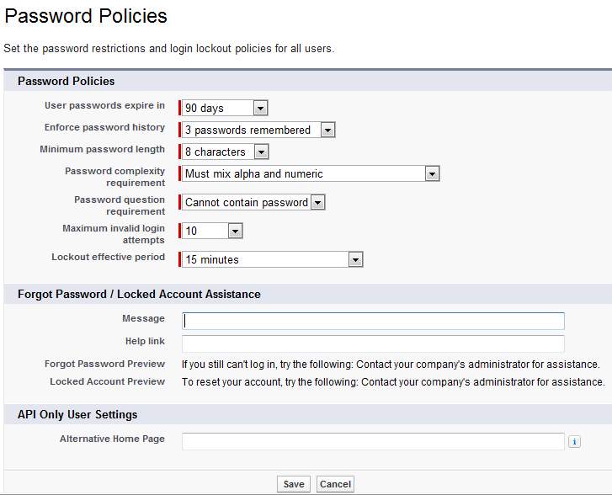
Password Policies
User can check password policies using
Select Setup | Admin setup | Security Control | Password Policies
Notes:
Field Description
User passwords expire in
permission are not affected by this setting. The default is 90
days. This setting is not available for Self-Service portals.
Save users’ previous passwords so that they must always reset
their password to a new, unique password. Password history
Enforce password history
is not saved until you set this value. The default is 3
passwords remembered. You cannot select No
passwords remembered unless you select Never
expires for the User passwords expire in field.
This setting is not available for Self-Service portals.
The minimum number of characters required for a password.
When you set this value, existing users aren’t affected until
Minimum password length
the next time they change their passwords. The default is 8
characters.
The requirement for which types of characters must be used
in a user’s password.
Complexity levels:
Password complexity requirement
• No restriction—allows any password value and is
the least secure option.
• Must mix alpha and numeric—requires at least
one alphabetic character and one number. This is the
default.
• Must mix alpha, numeric, and special
characters—requires at least one alphabetic character,
one number, and one of the following characters: ! #
$ % - _ = + < >.
The values are Cannot contain password, meaning
that the answer to the password hint question cannot contain
Password question requirement
the password itself; or None, the default, for no restrictions
on the answer. The user’s answer to the password hint
question is required. This setting is not available for
Self-Service portals, Customer Portals, or partner portals.
The number of login failures allowed for a user before they
become locked out. This setting is not available for
Self-Service portals.
Maximum invalid login attempts
The duration of the login lockout. The default is 15 minutes.
This setting is not available for Self-Service portals.
Lockout effective period
Note: If users are locked out, they must wait until
the lockout period expires. Alternatively, a user with
the “Reset Passwords and Unlock Users” permission
can unlock them by clicking Your Name > Setup
> Manage Users > Users, selecting the user, then
clicking Unlock. This button is only available when
a user is locked out.

Slide 56
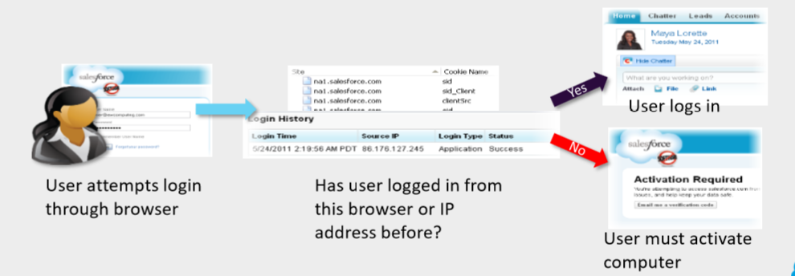
How does Login Work?
By default, Salesforce does not restrict the hours or the locations of user logins.
When users log in for the first time:
▪ A cookie is placed in their browser.
▪ Their IP address is added to a trusted list. When users log in again, Salesforce uses this information to authenticate them:

Slide 57
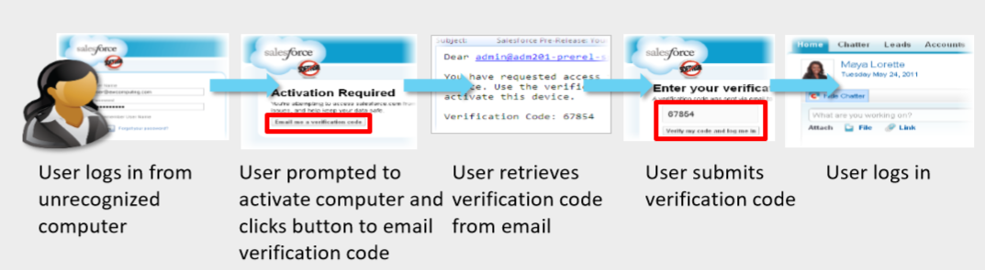
How does Activation works?
When a user attempts to log in from an unrecognised IP address using a browser that does not have the Salesforce cookie, they are prompted to activate their computer.
This process authenticates the user, adds the cookie, and adds the new IP address to the trusted list.

Slide 58
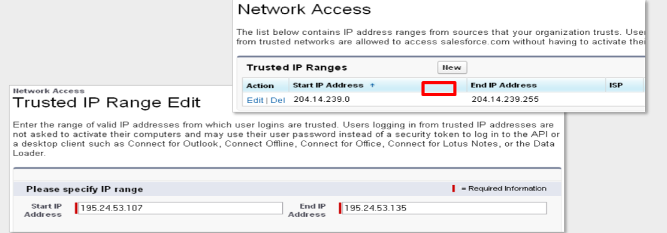
Creating an Organization-Wide Trusted IP Address List
You can manually add trusted IP address ranges for your organization, from which users can always log in without having to activate their computers.
This could be your office network or VPN.
Note that users would still be able to log in from addresses outside these ranges through the activation process.

Slide 59
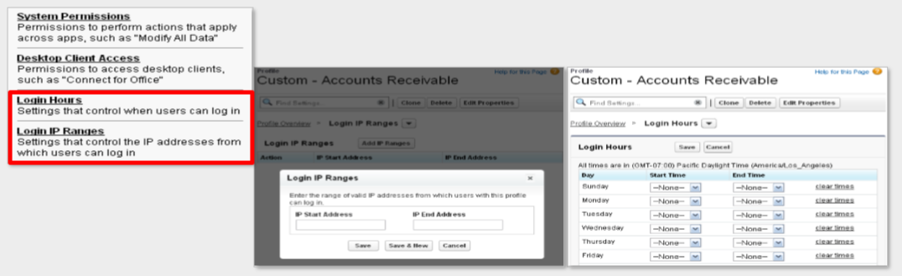
Restricting Login Hours and Login IP Ranges on Profiles
You can lock down access for particular groups of users by adding allowed hours and login ranges to their profiles. Users outside these hours or ranges will have their login denied.
Your Name | Setup | Manage Users | Profiles | Name of Profile

Slide 60
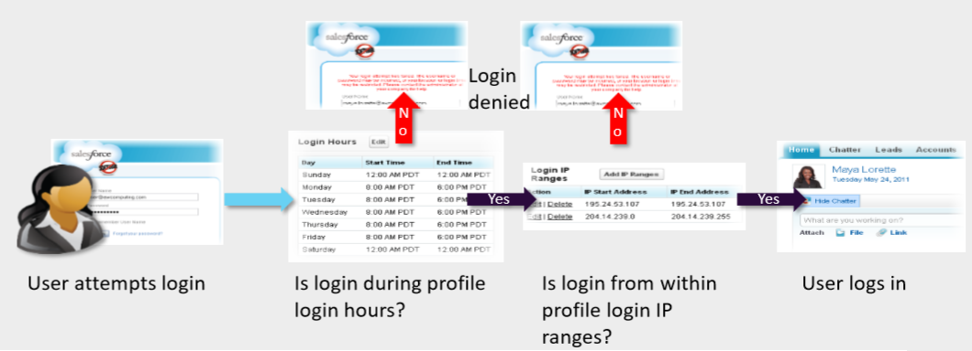
How does Profile Login Hours and IP Ranges Work?
If you want to allow for 24 hour access you need to specify that by using blanks. Choosing 12 AM – 12 AM effectively locks the user OUT.

Slide 61
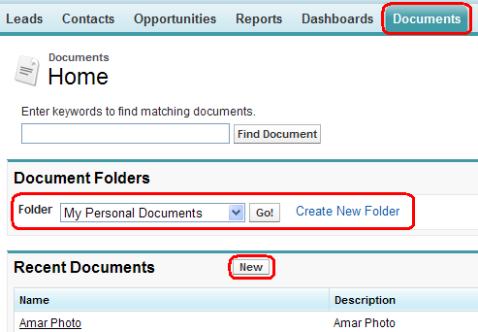
Folder Access
A folder is a place where user can store reports, dashboards, documents, or email templates

Slide 62
Summery
This module showed you how to:
Define Company Profile
Define User Interface setting
Create user profile
Create user Profiles
Define and Create User
Define Fiscal Year

Slide 63
Check Your Knowledge
1. True or False, One user can have multiple Profiles
A. TRUE
B. FALSE
2. Which feature is NOT available in Salesforce.com?
A. Profile based login hours
B. Profile based login IP ranges
C. Organization based login hours
D. Organization based login IP ranges
Notes:
2. D

Slide 64
Thank you

